Slide 1
Accessibility in the Design of Course Materials
Leveling the playing field in the information age

Slide 2
Thank you!
Alaina Beaver, Ph.D.
Francie Saunders
Brad Grabham
Doris Cheung
OIT, ASSETT, ATDT

Slide 3
What does accessibility mean?
“Despite the web's great potential for people with disabilities, this potential is still largely unrealized. … What if the internet content is only accessible by using a mouse? What do people do if they can't use a mouse? And what if web developers use graphics instead of text? If screen readers can only read text, how would they read the graphics to people who are blind? … The internet has the potential to revolutionize disability access to information, but if we're not careful, we can place obstacles along the way that destroy that potential and which leave people with disabilities just as discouraged and dependent upon others as before.”
From http://webaim.org/intro/, accessed 11/30/16

Slide 4
What does accessibility mean?
“The Web Content Accessibility Guidelines (WCAG) provide an international set of guidelines. They are developed by the Worldwide Web Consortium (W3C), the governing body of the web. These guidelines are the basis of most web accessibility law in the world. Version 2.0 of these guidelines, published in December 2008, are based on four principles:
Perceivable: Available to the senses (vision and hearing primarily) either through the browser or through assistive technologies (e.g. screen readers, screen enlargers, etc.)
Operable: Users can interact with all controls and interactive elements using either the mouse, keyboard, or an assistive device.
Understandable: Content is clear and limits confusion and ambiguity.
Robust: A wide range of technologies (including old and new user agents and assistive technologies) can access the content.”
From http://webaim.org/intro/, accessed 11/30/16

Slide 5
We’re not “the web,” so what is accessibility for us as researchers and educators?
To me personally, this means that
People who have cognitive or sensory impairments find it possible to utilize information and systems we provide and employ in our work
People who use assistive technologies can have those technologies actually work with our materials and systems

Slide 6
Accessibility
We have a legal obligation
Our University has compelled us to make all our materials and systems more accessible
It is a civil rights issue: democratizing access to information and opportunities for learning and professional growth
→ Morally, professionally, and legally, it’s the right thing to do. Win win win!

Slide 7
Focus for Today
Working with PowerPoint
Text
Images

Slide 8
Demo of real materials
What do students with Screen Readers do?
How can you make your materials work for students using screen readers?

Slide 9
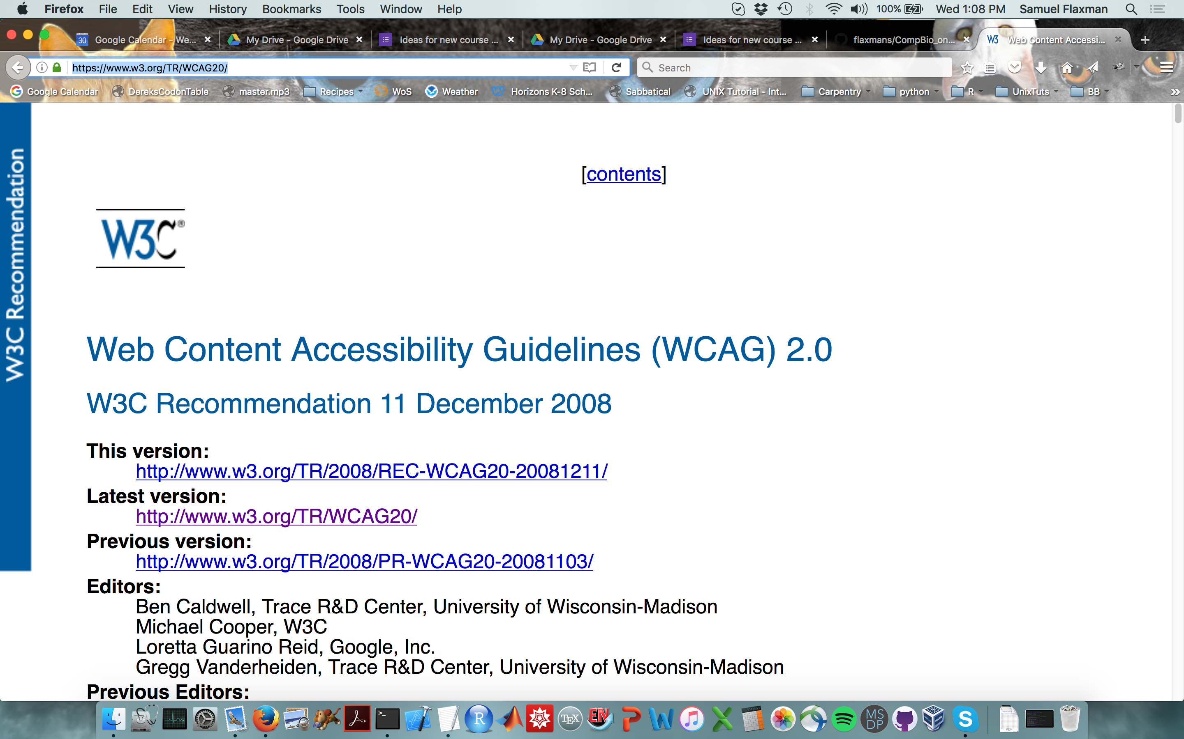
Guidelines for accessible color choice
Alt-text for image: screenshot of Web Content Accessibility Guidelines (WCAG) 2.0 from https://www.w3.org/TR/WCAG20/

Slide 10
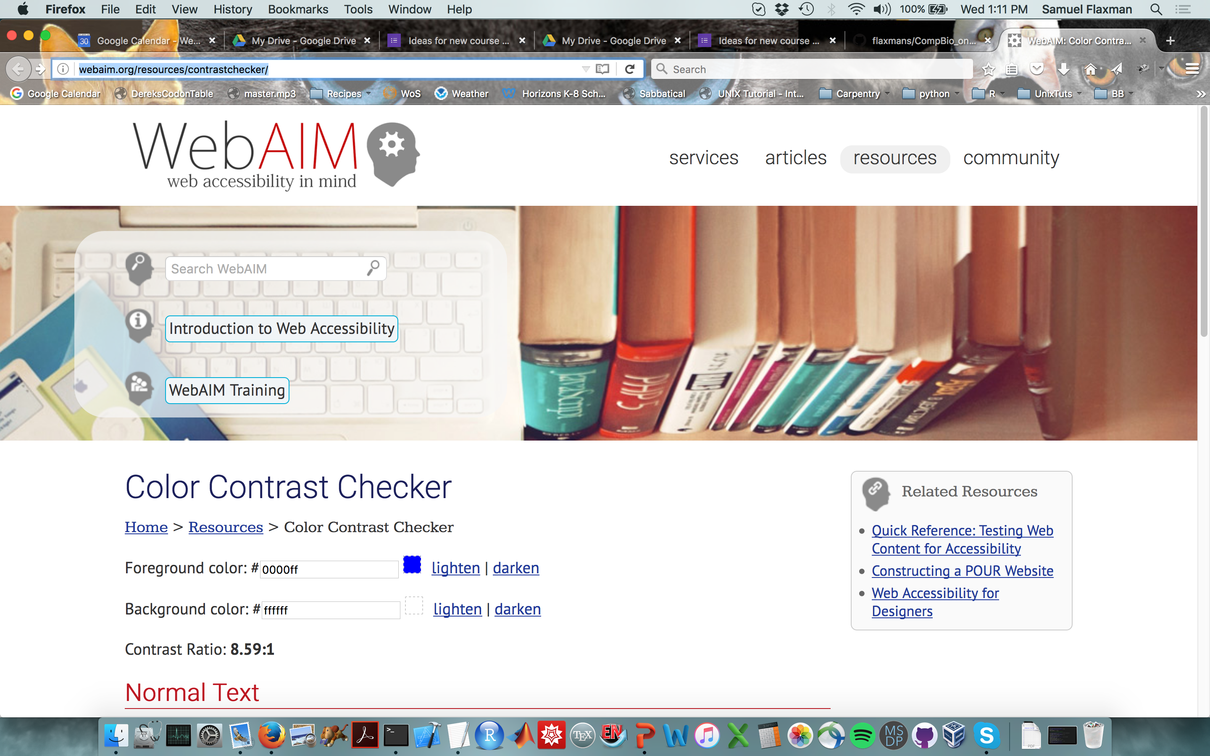
Tool for checking accessible font color choices
Alt-text for image: screenshot of Web Aim’s color contrast checker tool, http://webaim.org/resources/contrastchecker/

Slide 11
“How can I make my professional materials accessible?”
Learn to do some on your own
Apply for course/program fees to hire an undergrad who can be trained and then convert your course materials for you to review later
Great for you
Great for the undergrad’s CV
OIT has resources to help answer questions
When you create new materials, create them with accessibility in mind. It really is NOT much extra time at the creation stage! It’s just using PowerPoint slightly differently!
Campus has a captioning service for videos. If a student specifically requests captioning, the captioning service covers the cost.

Slide 12
Thank you!
Alaina Beaver, Ph.D.
Francie Saunders
Brad Grabham
Doris Cheung
OIT, ASSETT, ATDT

